Slide 1



fall detection project
Farnaz Golnam
MSCS #19576

Slide 2
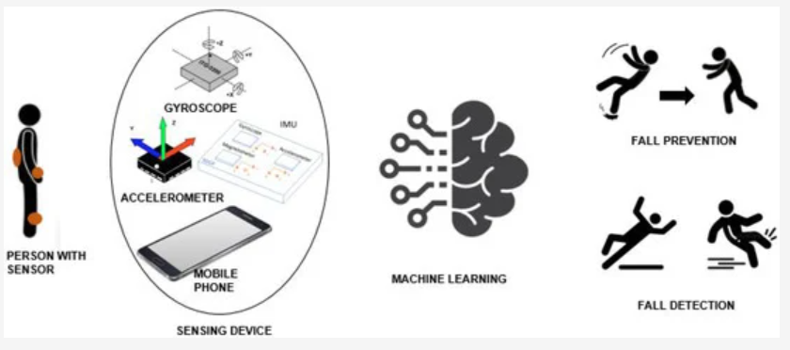
Image reference: https://www.mdpi.com

Slide 3

Fall Detection Project contents
Client side
Server side
Creating Machine learning model
SQLite data base
Directory of files

Slide 4
Creating Machine learning Model
Dataset to train the model
refer to Fall_Detection_Dataset.csv file in the directory of files
this dataset used for training deep learning neural network(DNN) model
Build and train the DNN model
refer to LogisticRegression.py file in the directory of files
the result of the DNN will uses a sigmoid classifier to classify the results as either 0 or 1 which indicates fall
Convert the result file format
refer to LogisticRegression.h5 and LogisticRegression.tflite files in the directory of files
the trained network result is in h5 format which is quite large to use in android application, for this reason android only accepts tflite format which has smaller size

Slide 5
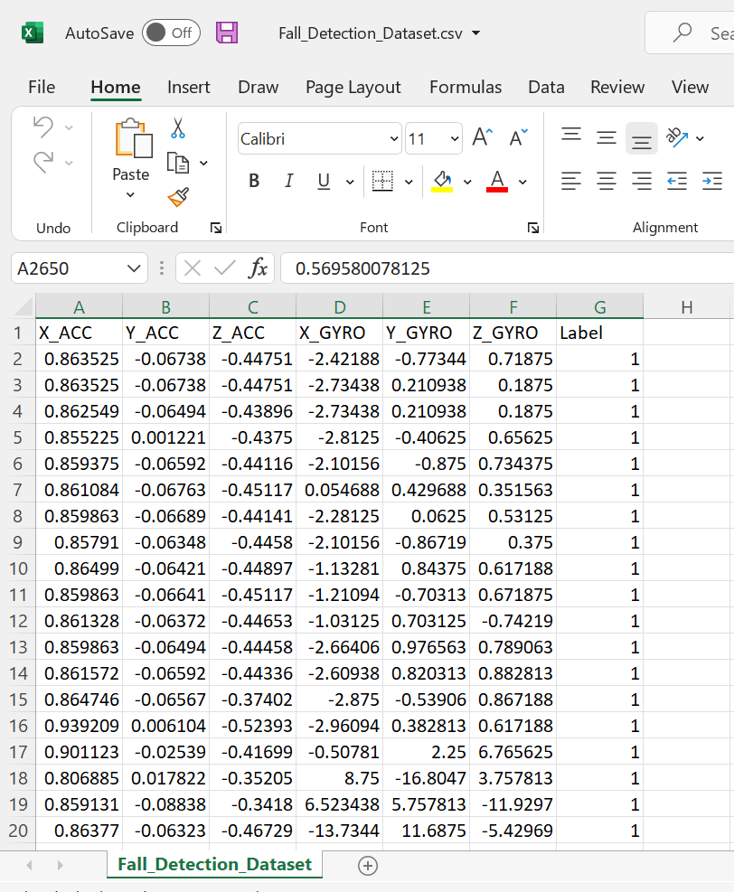
DataSet to train the model
It has 7 columns including:
X_ACC,
Y_ACC,
Z_ACC,
X_GYRO,
Y_GYRO,
Z_GYRO,
Label

Slide 6
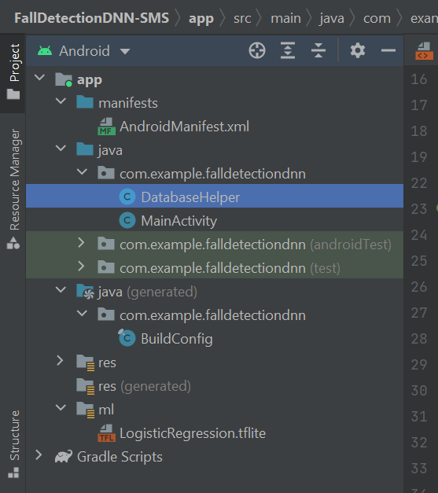
client side, android application
The result of the DNN trained network file will be loaded in to FallDetectionDNN.app in android studio.
The application now includes:

Slide 7
LogisticRegression.tflite file to use the DNN trained network result
Refer to the LogisticRegression.tflite file in directory of files for the source code
Androidmanifest.xml file to define the application basics such as name or the permission to get the app access the internet
Refer to the Androidmanifest.xml file in directory of files for the source code
activity_main.xml file to define the frontend of the app such as buttons and frames
Refer to the activity_main.xml file in directory of files for the source code
DatabaseHelper.java which defines the SQLite database itself
Refer to the DatabaseHelper.java file in directory of files for the source code
MainActivity.java which defines all the functionality of the app
Refer to the MainActivity.java file in directory of files for the source code

Slide 8
MainActivity.java which defines all the functionality of the app such as
defining accelerometer and gyroscope sensor data/values using
SensorManager()
defining and creating a database to save collected data using DatabaseHelper()
saving the collected sensor data into Database using
save to DB()
collecting sensor data using
SensorEventListener()
detecting the patient`s location by getting permission from the gps app to get the location using getLocation()
detected fall is sending to server with a massage along with the location using
SendToServer()
detected fall is sending to specified phone number with a SMS along with the location using SendSMSMessage()
sending the sensor values to the trained network to detect 0 or 1(Fall) using
do Inference ()

Slide 9
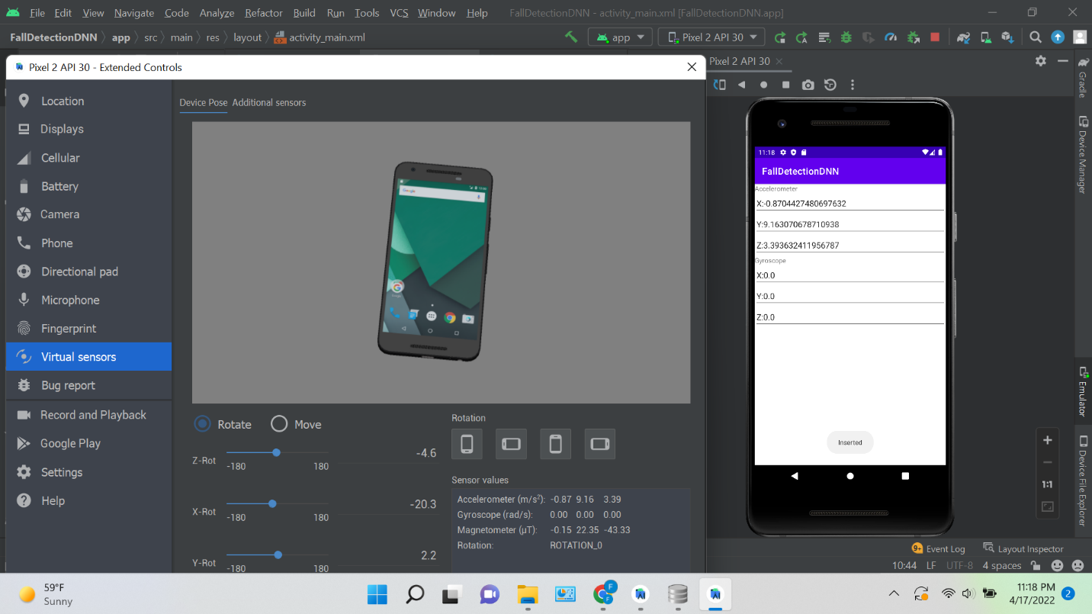
The Accelerometer and Gyroscope data

Slide 10
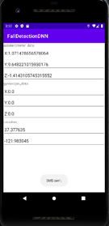
Sending SMS messages

Slide 11
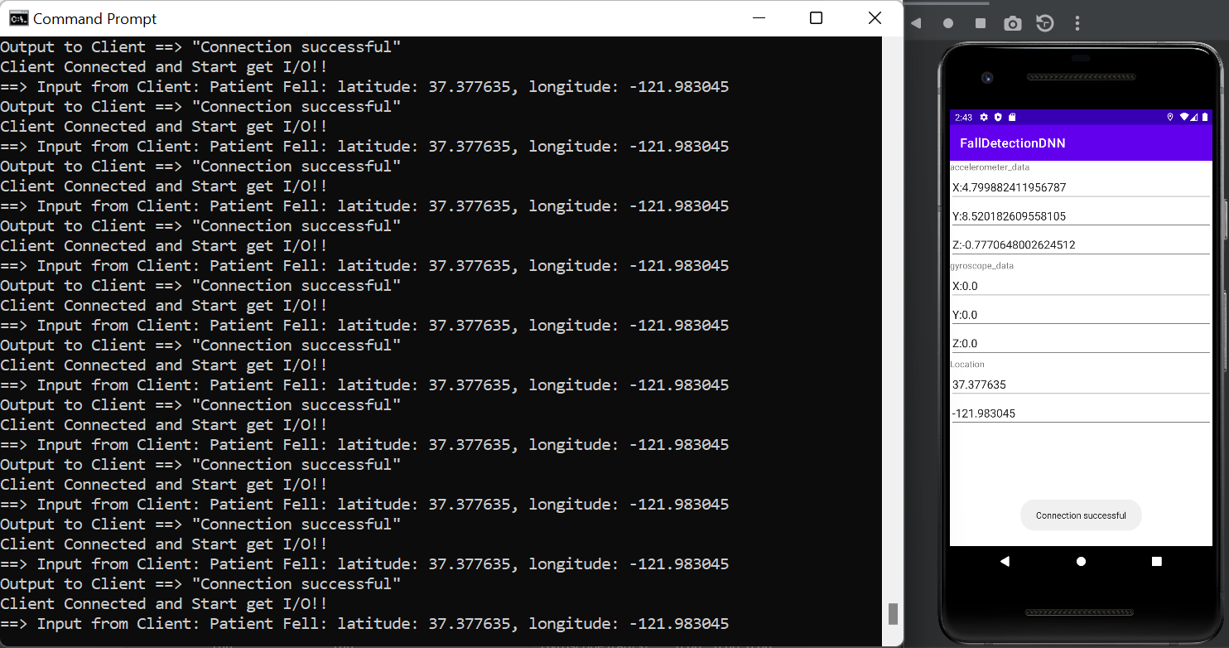
Server Side
Server is running on another computer; it listens to the port when it receives the patient`s fall message along with the location through the android application, the command prompt then opens showing the input data received by server

Slide 12
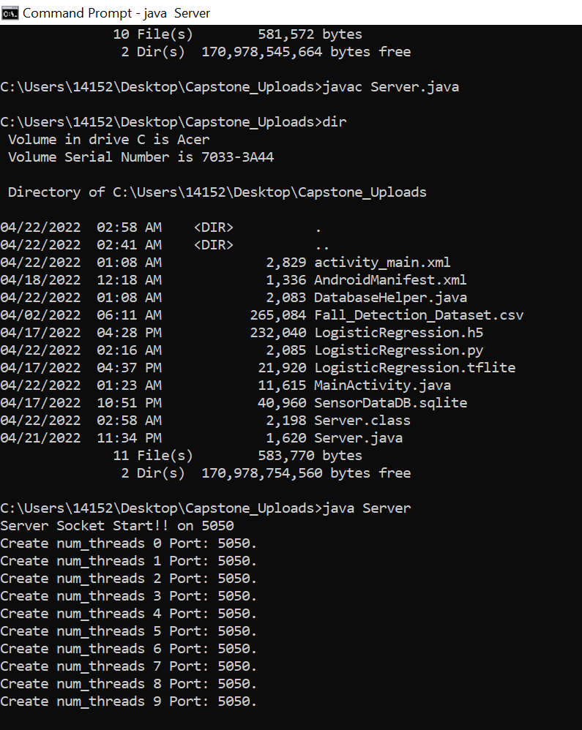
To run the server:
Compile Server.java file by running ‘javac Server.java’ on Command Prompt to generate ‘Server.class’, and then run ‘java Server’

Slide 13
refer to Server.java file in the directory of files for source code

Slide 14
SQLite Data Base
The data collected from accelerometer and gyroscope sensors are being saved into an SQLite database
Define the database:
Refer to DatabaseHelper.java which defines the SQLite database itself
2. Save the data into the database
Refer to MainActivity.java in the android app
SaveToDB( ) function
Refer to the SensorDataDB.sqlite to see the saved data

Slide 15
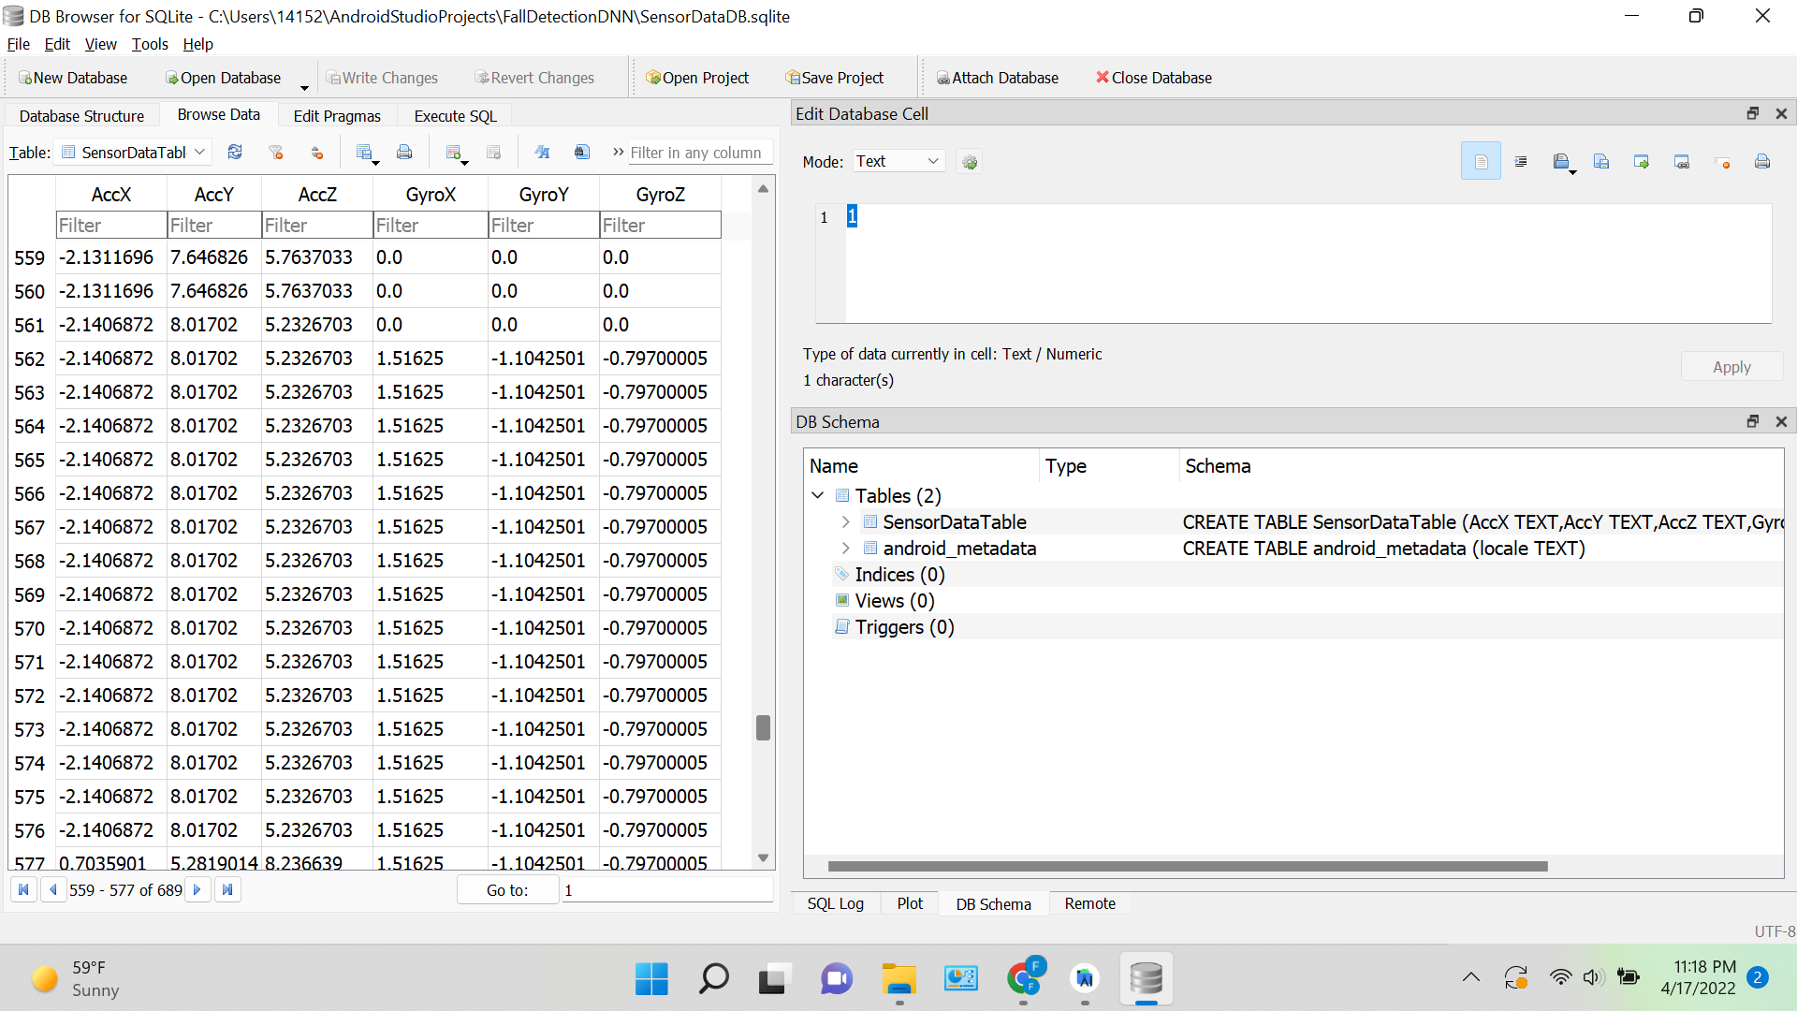
DB Browser (SQLite) App is used to inspect the collected sensor data

Slide 16
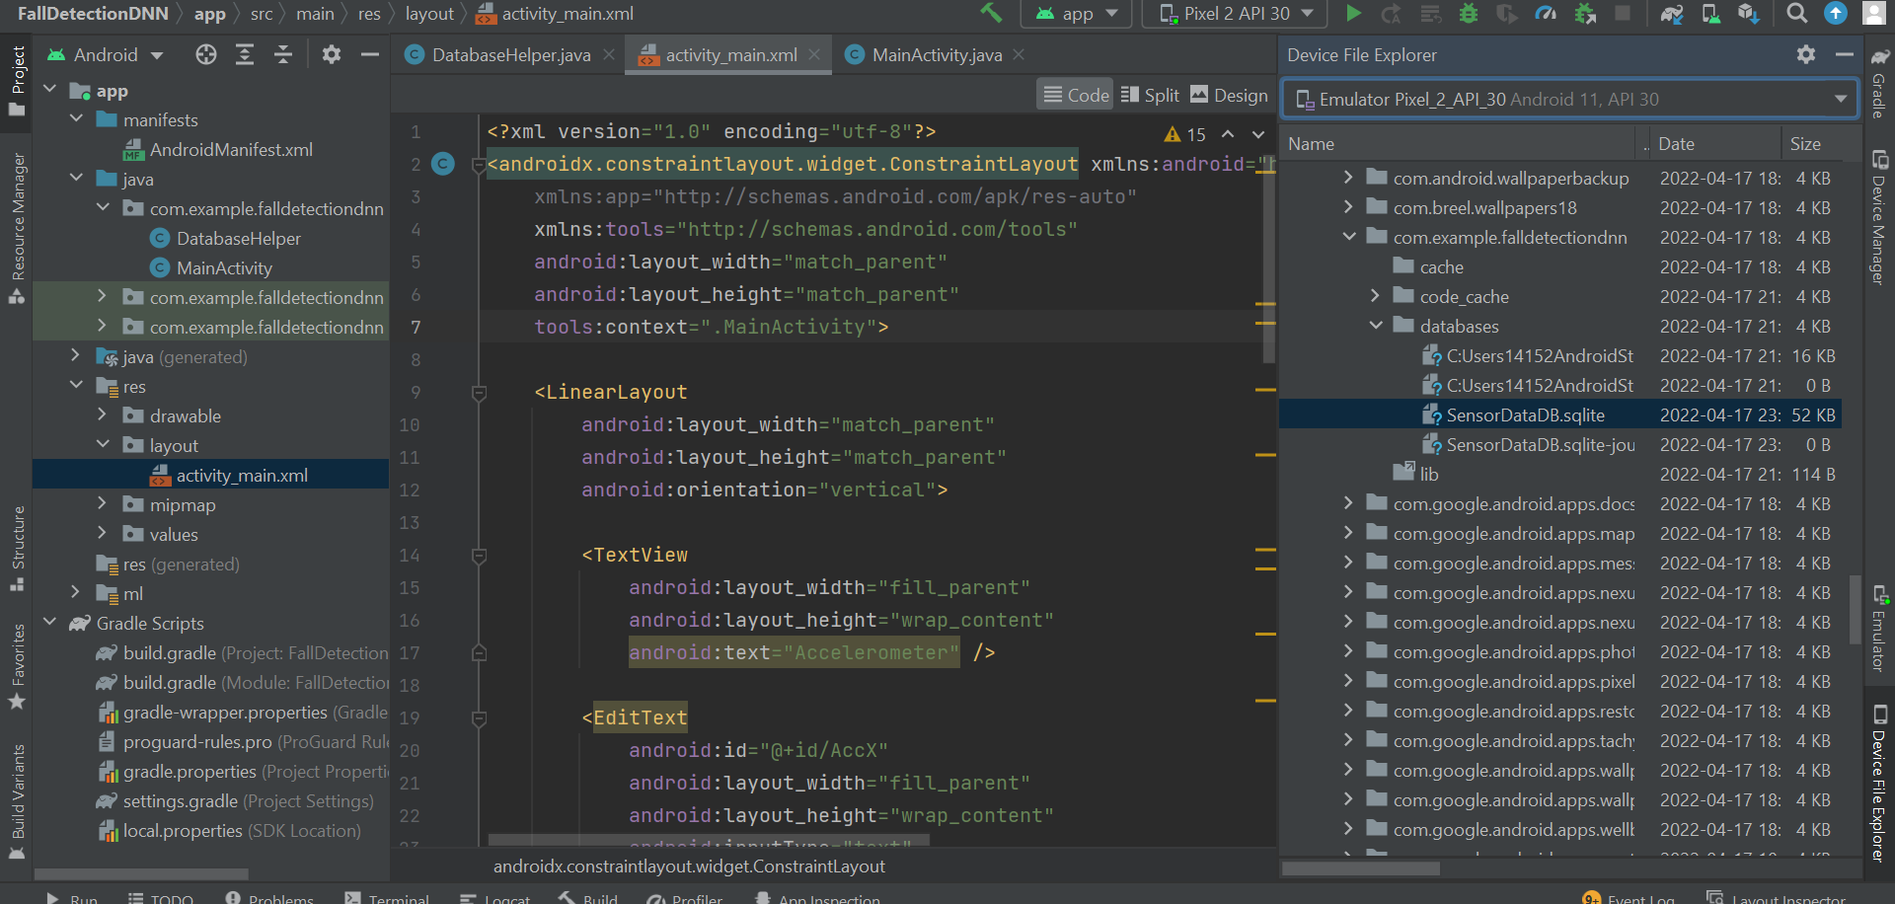
Finding the path where data is stored
/data/data/com.example.falldetectiondnn/databases/SensorDataDB.sqlite

Slide 17
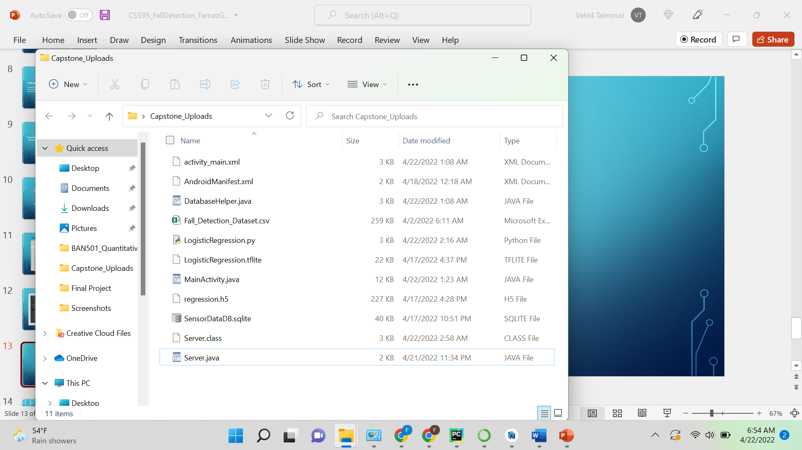
Directory of files

Slide 18
Thank you
Farnaz Golnam
MSCS 19576

